Slide 1
Deep Learning Assessments
Early Detection of Cerebral Palsy in Infants

Slide 2

Introduction
This presentation explores the potential of deep learning methodologies to enhance early detection of Cerebral Palsy (CP) in infants, focusing on innovative approaches that can transform traditional diagnostic practices.

Slide 3

01
CP Overview

Slide 4
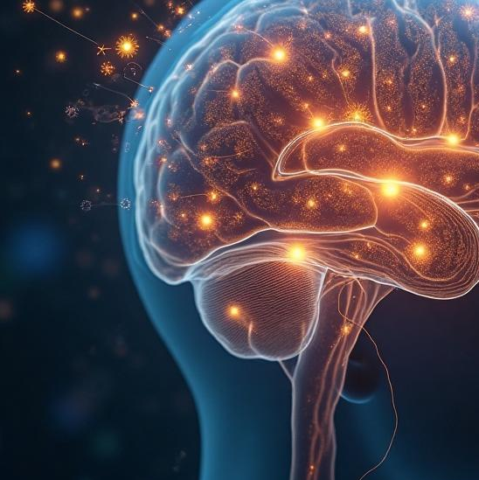
Definition and types of Cerebral Palsy
Cerebral Palsy (CP) encompasses a variety of movement disorders caused by brain damage occurring during fetal development, childbirth, or shortly after. It primarily affects muscle tone, posture, and movement, resulting in challenges that vary from mild to severe, including spastic, dyskinetic, ataxic, and mixed types.

Slide 5
Importance of early diagnosis
Early diagnosis of CP is vital for implementing timely interventions, which can significantly mitigate the severity of motor impairments. Identifying CP at an early stage allows for tailored therapeutic strategies that improve overall outcomes for affected infants, enhancing their quality of life and developmental trajectory.

Slide 6
Challenges in traditional assessment methods
Traditional assessment methods for Cerebral Palsy involve subjective clinical evaluations that can lead to delayed diagnosis. These methods rely heavily on physical examinations and developmental milestones, which can vary significantly among infants. As a result, some cases may be overlooked or incorrectly diagnosed, leading to missed opportunities for early intervention.

Slide 7

02
Deep Learning in CP Detection

Slide 8
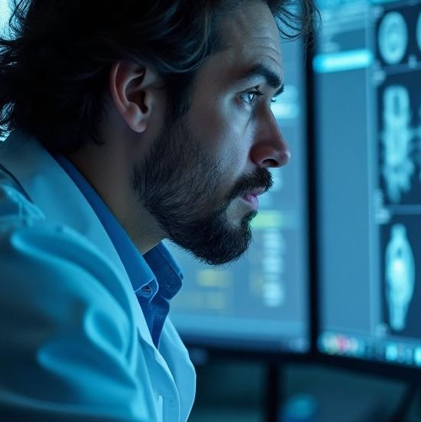
Role of deep learning in medical diagnostics
Deep learning has revolutionized medical diagnostics by enabling the analysis of vast datasets through algorithms that can learn and identify intricate patterns. In the context of detecting Cerebral Palsy, deep learning models can process imaging data, clinical records, and sensor data to enhance diagnostic accuracy and efficiency.

Slide 9
Advantages over traditional methods
Deep learning approaches boast several advantages compared to traditional diagnostic methods. They offer improved accuracy and quicker processing times, minimizing human error and bias. These models can also operate continuously and adaptively, learning from new data and evolving to recognize subtle indicators of CP that may be missed by clinicians.

Slide 10
Overview of methodology and datasets used
The proposed methodology involves collecting a comprehensive dataset over the past ten years, including diagnostic imaging, clinical assessments, and patient history. Data preprocessing will address missing values and normalize variations to prepare the dataset for training deep learning models, particularly Convolutional Neural Networks (CNNs), which have shown promise in medical image classification.

Slide 11
Conclusions
In conclusion, integrating deep learning technologies into the diagnosis of Cerebral Palsy holds the potential to significantly enhance early detection rates. By overcoming the limitations of traditional assessment methods, this innovative approach can lead to timely interventions, ultimately improving outcomes for affected infants.

